Slide 1
EXPERIMENT REPORT

Slide 2
Aim
Short statement about what you were trying to find out by doing the experiment.
It should start by “ To + verb”
e.g. “to investigate the effect of temperature
on the electric resistance of a metal”
“to determine the relationship between the
corrosive properties of a solution and its
concentration in acid”

Slide 3
Hypothesis
Your best educated guess of what you thought you would discover.
It is a proposed description (and/or explanation) of a phenomenon.
It has to be testable.
Experimenters may test and reject several hypotheses before solving the problem.
Scientists generally base scientific hypotheses on previous observations that cannot satisfactorily be explained with the available scientific theories.
Even though the words "hypothesis" and "theory" are often used synonymously, a scientific hypothesis is not the same as a scientific theory.
A scientific hypothesis is a proposed explanation of a phenomenon which still has to be rigorously tested. In contrast, a scientific theory has undergone extensive testing and is generally accepted to be the accurate explanation behind an observation.

Slide 4
Variables
A variable is any factor / parameter that can be changed, measured or controlled in an experiment.
The independent variable is the one condition that you change in an experiment.
The dependent variable is the variable that you measure or observe. The dependent variable gets its name because it is the factor that is dependent on the state of the independent variable.
A controlled variable is a variable that does not change during an experiment: there are usually many of them, as in a fair test, only the independent and the dependent variables should change.

Slide 5
Control experiment
A control group in a scientific experiment is a group separated from the rest of the experiment where the independent variable being tested cannot influence the results.
This isolates the independent variable's effects on the experiment and can help rule out alternate explanations of the experimental results. Control groups can also be separated into two other types: Positive control groups are groups where the conditions of the experiment are set to guarantee a positive result. A positive control group can show the experiment is functioning properly as planned.
Negative control groups are groups where the conditions of the experiment are set to cause a negative outcome. Control experiments are not necessary to all scientific experiments.
Controls are extremely useful where the experimental conditions are complex and difficult to isolate.

Slide 6
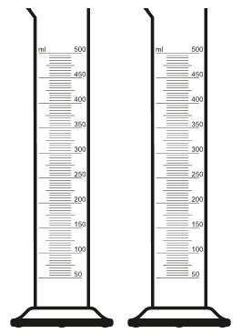

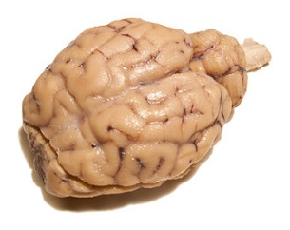
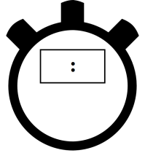
Equipment
A list of equipment and chemicals that were used.
e.g. meter ruler
2 x 100 mL measuring cylinders
stopwatch
10 mL of copper sulfate solution (0.1 mol.L⁻¹)
1 sheep’s brain

Slide 7
Risk assessment
List of the things that are the most likely to go wrong during the experiment.
These include things that are as a direct result of your experiment (e.g. heated glass beaker may shatter) but not general risks that already exist and are unrelated to your experiment (e.g. ceiling may collapse during experiment).
Classify the risks according to the severity of the damage they would create.
Only state the risks that are the most likely to happen with the most severe outcome.
You should also explain how you can protect yourself against these risks.

Slide 8
Method / Instructions
A set of steps outlining how to do the experiment (like a cooking recipe).
Include enough detail to allow the reader to repeat your experiment.
Do not include the analysis of your results (calculations, graphs…)
Allow for several trials to be made for each measurement, as it will increase the reliability of your results.

Slide 9
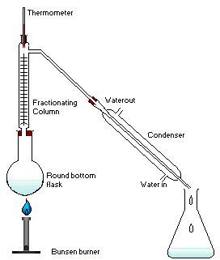
Diagram
A precise, neat and labelled 2D-sketch showing how your equipment was set up.
The independent and the dependent variables should be represented in the diagram.
When a change occurs during the experiment (colour, effervescence, disappearance of a chemical), it might be necessary to draw more diagrams to show this evolution.
Include enough detail to allow the reader to repeat your experiment.

Slide 10
Observations / Results
State all the relevant/meaningful observations you have recorded.
When possible, present your results in the form of a table.
Units in headings
Consistent precision (e.g. if you have 1.9 V in the table, then you should also write 3.0 V and not 3 V).
Precision cannot be gained through calculations (e.g. when calculating an average): precision is determined by the precision of your measuring device (e.g. stopwatch, meter ruler, pH-meter…)
If any calculations are to be made (e.g. average speed, electrical resistance…), show all working.

Slide 11
Graphs
They help you visualise your results and identify trends among them.
Line and bar graphs can be used.
If not told otherwise, place your independent variable on the x-axis of your graph and the dependent variable on the y-axis.
The 2 axes must be labelled (physical quantities and units).

Slide 12
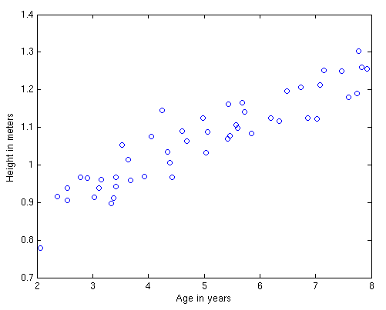
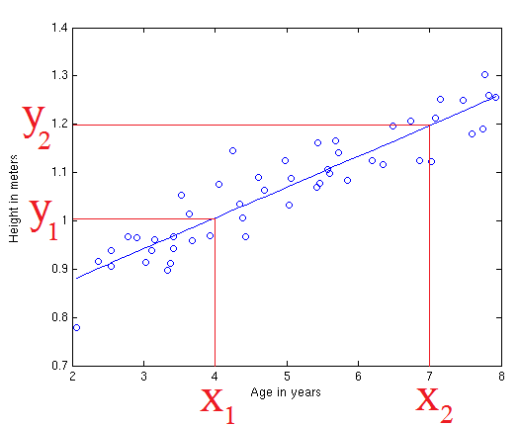
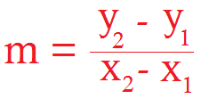
A line/curve of best fit must be drawn.
If the determination of the gradient of the line of best fit is required, all working should be apparent.
=>

Slide 13
Discussion
An analysis of your results and a description of any difficulties that you had with the experiment. It might also include suggestions for improvements to the experiment.
First, comment on the validity of the method used.
Then describe your results & comment on them, especially if they differ from what was expected (provide the reader with an explanation).
Then assess the reliability and the accuracy of your results.
Validity: use a formula to assess the method.
Reliability: repetition, variation, outliers.
Accuracy: equipment used.

Slide 14
Create paragraphs to separate your comments.
Avoid expressions such as “we can clearly see” or “obviously”.
Do not explain that the equipment was not working properly: you should have changed it as you were performing the experiment (any changes to the equipment used or to the method should be stated and justified).
Human error is not an acceptable explanation for any issue with the equipment used or the data gathered: increase your focus and your precision when performing the experiment.

Slide 15
Conclusion
A brief account of what you found out and how your findings relate to your aim.
State if your hypothesis was verified or not.
If not, provide the reader with a brief statement to suggest why.
It is a good idea to read your “aim” and your “hypothesis” again before you write your conclusion.

